Slide 1
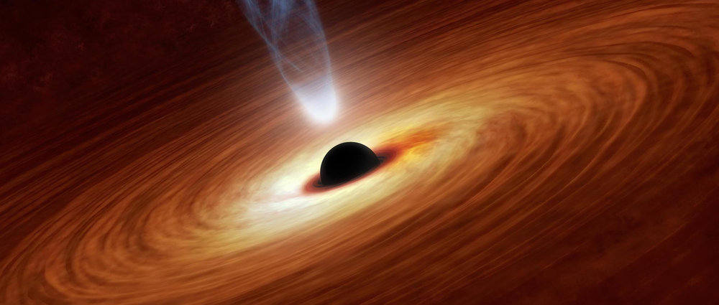







Large Sample Studies of Blazar Spectral Indices
2022 ASROC Annual Meeting
Po-Chih Hsu (許博智)
Graduate Institute of Astronomy, NCU & ASIAA
Supervisor:
Chorng-Yuan Hwang (IANCU); Jun Yi Koay (ASIAA); Matsushita Satoki (ASIAA)
2022/9/30 @NCCU
https://www.pmsutter.com/shows/askaspaceman-archive/2017/10/17/aas-69-what-makes-a-blazar-blaze-so-brightly

Slide 2
Outlines
Blazar Introduction
Data
Results and Discussion
Conclusion

Slide 3
Introduction
Active Galactic Nuclei
A compact region at the center of a galaxy
Very luminous emission power by accretion on a SMBH
Blazar
BL Lac object (BLO) & flat spectrum radio quasar (FSRQ)
A highly variable active galaxy, small viewing angle of its relativistic jet
Emission at all frequencies in EM spectrum
Flat spectrum sources are more variable than steep spectrum sources

Slide 4
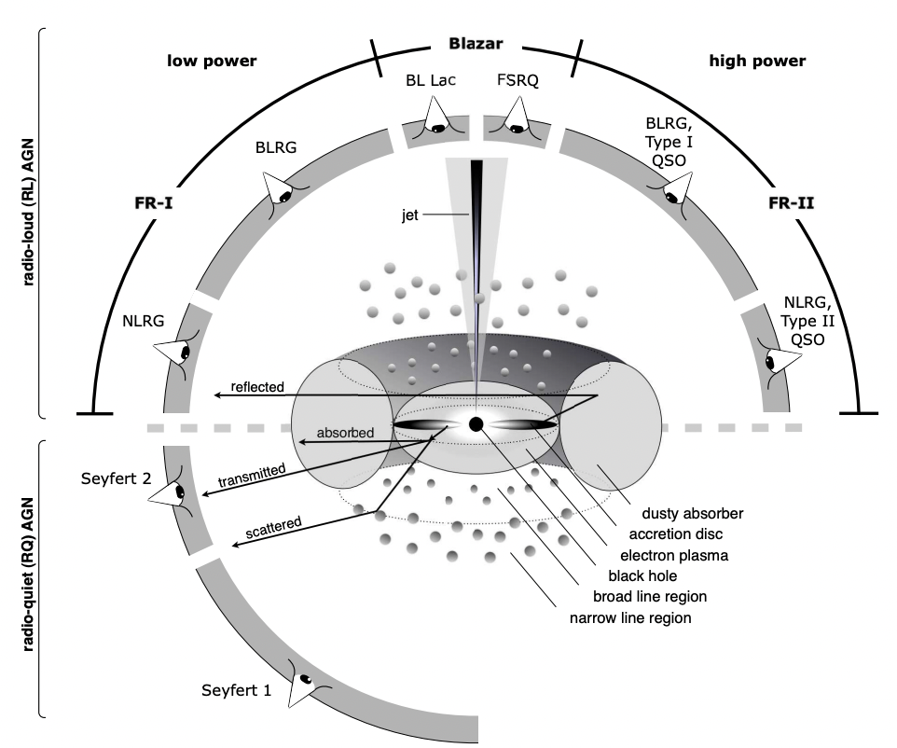
Introduction
Low power
High power
BL Lac
Less powerful
Later stage of evolution
Steep spectrum
BL Lac
FSRQ
AGN
Unification
Model
FSRQ
More powerful
Early stage of evolution
Flat (radio) spectrum
Beckmann & Shrader (2012)
Notes:
An active galaxy can used it emitting energy to classified into high and low galaxy
BL Lac objects are classified as low power AGN
Introduce properties
FSRQs hs been classified as high power AGN
=> introduce FSRQ properties
In this study we would like to investigate the spectra index difference of BL Lac object and FSRQ
=====================================================================
BL Lac is a highly variable radio loud source.
It has no emission line and shows strong polarization
FSRQ is a star like object, with some high redshifted emission line.
also, it only contains small fraction in radio galaxies.

Slide 5
Data
Main samples
The 5-th edition Roma-BZCAT Multifrequency Catalog of Blazars (ROMA-BZCAT, Massaro et al., 2015b)
ALMA Calibrator Catalog (ACC, Bonato et al., 2019)
** 1367 sources overlap (r = 1’)
Other multifrequency data
Radio: GLEAM, FIRST, VLASS
mm/sub-mm: ACC, BZCAT 143 GHz
OIR: WISE, SDSS, XMM-OM
x-ray: SWIFT-BAT, XMM-Newton, ROSAT
γ-ray: BZCAT 1-100 GeV, EGRET, Fermi-LAT
Notes:
ROMA-BZCAT: 3561 blazars, source type and redshift information are include in the catalog
ACC: 3364 blazars, source declination can be low as -60 degree, and contains lots of galactic plane sources
For other frequency data, we used online archival data
All frequency and flux in the study has been transfer into rest frame and K-corrected
We calculate the spectral index of each source, and trying to do some statistic of BL Lac and FSRQs
We perform three different statistical test, two sample komogorov-smirnov test (K-S test), and F-test and T-test

Slide 6
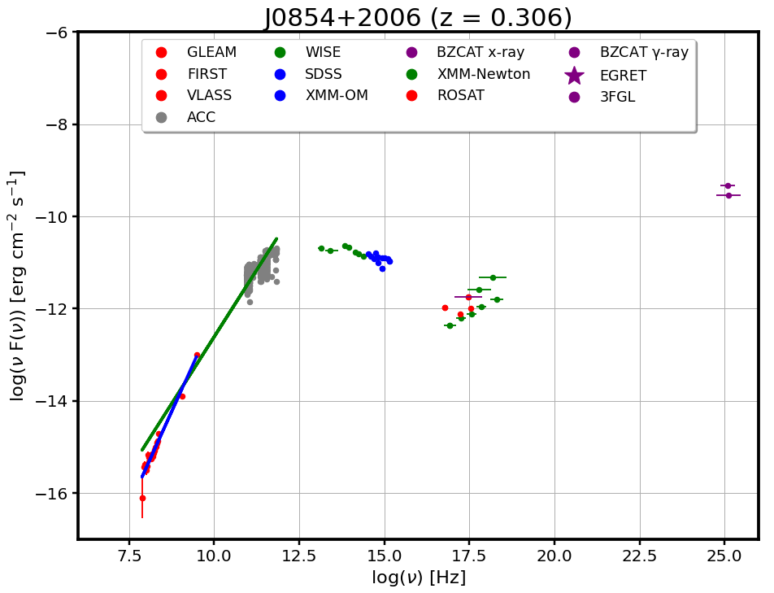


Data
$α_{radio−mm}$ (radio-mm spectral index)
$α_{radio}$ (radio spectral index)
Notes:
ROMA-BZCAT: 3561 blazars, source type and redshift information are include in the catalog
ACC: 3364 blazars, source declination can be low as -60 degree, and contains lots of galactic plane sources
For other frequency data, we used online archival data
All frequency and flux in the study has been transfer into rest frame and K-corrected
We calculate the spectral index of each source, and trying to do some statistic of BL Lac and FSRQs
We perform three different statistical test, two sample komogorov-smirnov test (K-S test), and F-test and T-test

Slide 7
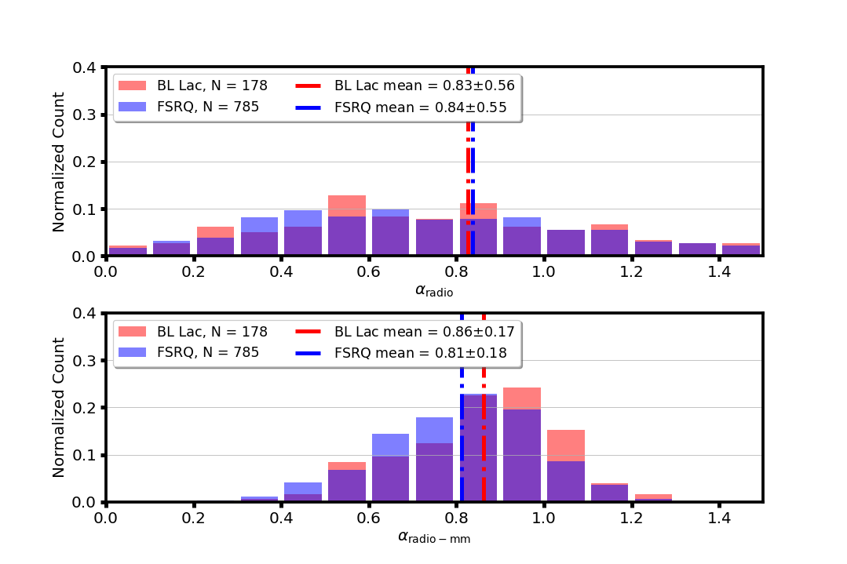
Results and Discussion
The $α_{radio}$ mean value and distribution of BL Lac and FSRQs are similar under F-T test
FSRQs has steeper $α_{radio−mm}$ than BL Lacs
Radio
spectral
index
BL Lac
FSRQ
BL Lac mean value
FSRQ mean value
Radio-mm
spectral
index
Notes:
Top panel shows the radio spectral distribution of BL Lac and FSRQ
Bottom panel shows the radio-mm spectral index of BL Lac and FSRQ
Red histogram are BL Lac
Blue histogram are QSO
mean: dashed dot line
K-S test: is to test of those two distribution are from same sample
F test: compares the ratio of the variances of two populations
T test: check the unknown population means value of two pair of groups are equal

Slide 8
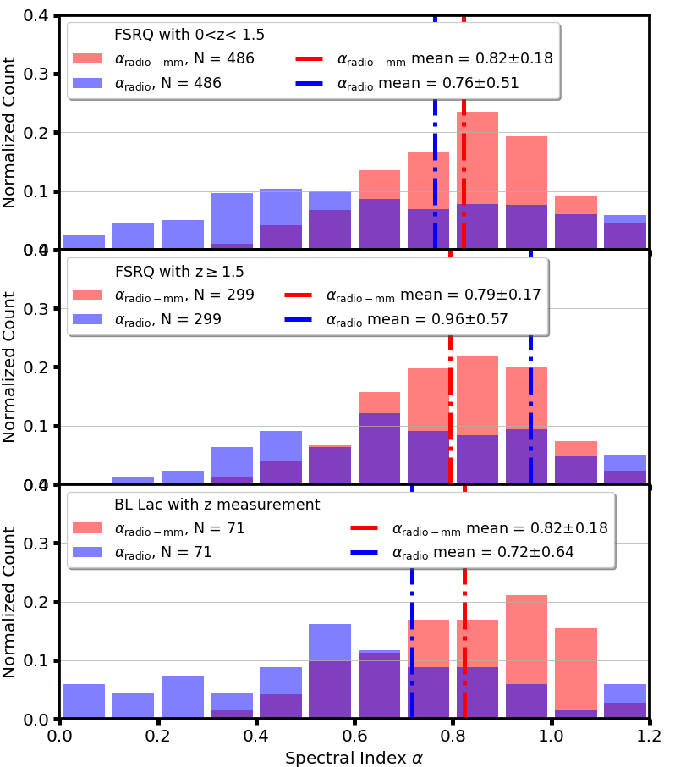


Results and Discussion
$α_{radio−mm}$
$α_{radio}$
$α_{radio−mm}$ mean
$α_{radio}$ mean
High z FSRQs has significant flatter $α_{radio}$ distribution and mean value than low z FSRQs
No significant difference detected of $α_{radio}$between low z FSRQs and BL Lacs
Low z FSRQs and BL Lacs has similar$α_{radio−mm}$ mean value, and their distribution have no difference
Notes:
top panel is low z QSO, middle panel is high z QSO, and bottom panel is BL Lac with redshift measurement
red histogram is radio-mm spectral index
blue histogram is radio spectral index
mean: dashed dot line
median: dashed line

Slide 9


Results and Discussion
$α_{radio−mm}$
$α_{radio}$
$α_{radio−mm}$ mean
$α_{radio}$ mean
High z FSRQs has significant flatter $α_{radio}$ distribution and mean value than low z FSRQs
No significant difference detected of $α_{radio}$between low z FSRQs and BL Lacs
Low z FSRQs and BL Lacs has similar$α_{radio−mm}$ mean value, and their distribution have no difference
Notes:
top panel is low z QSO, middle panel is high z QSO, and bottom panel is BL Lac with redshift measurement
red histogram is radio-mm spectral index
blue histogram is radio spectral index
mean: dashed dot line
median: dashed line

Slide 10
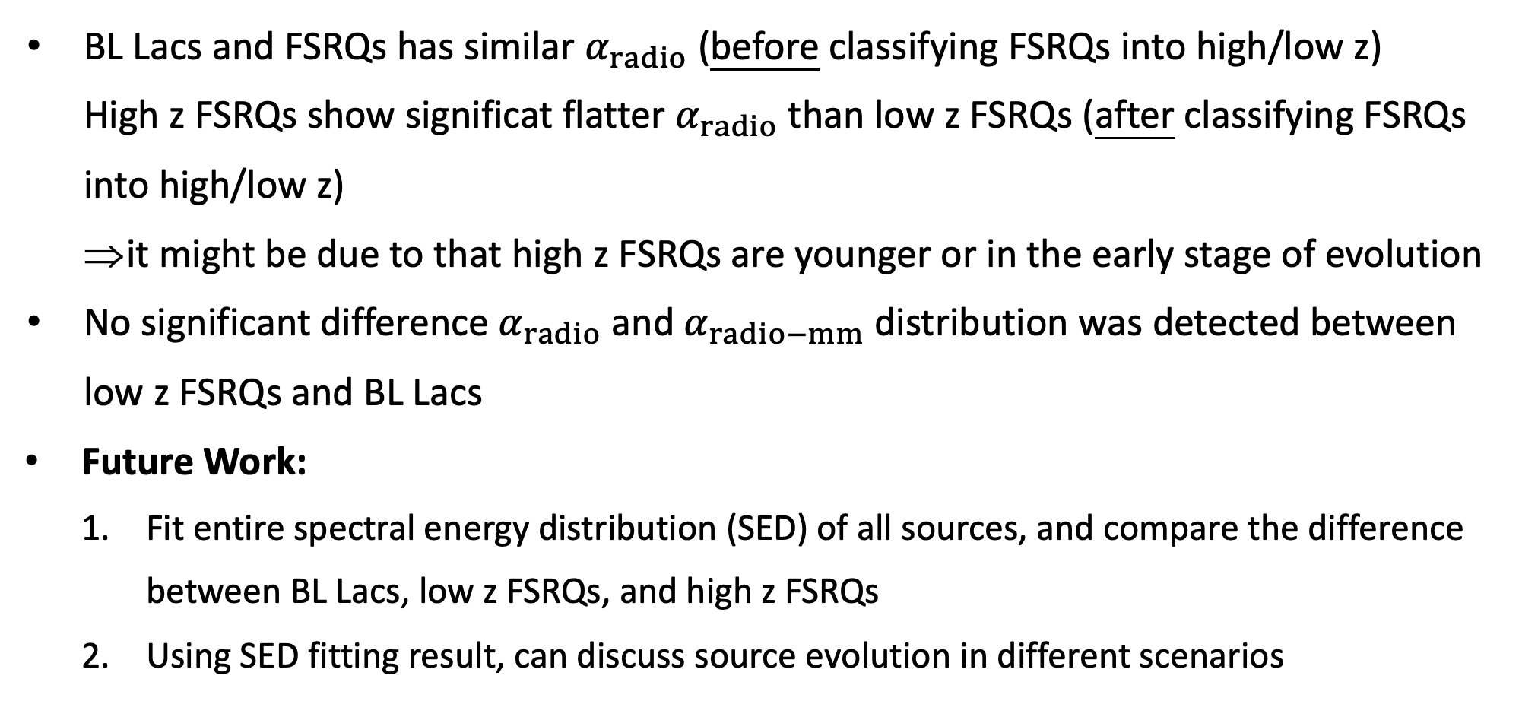
Conclusion
BL Lacs and FSRQs has similar $α_{radio}$ (before classifying FSRQs into high/low z)
High z FSRQs show significat flatter $α_{radio}$ than low z FSRQs (after classifying FSRQs into high/low z)
it might be due to that high z FSRQs are younger or in the early stage of evolution
No significant difference $α_{radio}$ and $α_{radio−mm}$ distribution was detected between
low z FSRQs and BL Lacs
Future Work:
Fit entire spectral energy distribution (SED) of all sources, and compare the difference between BL Lacs, low z FSRQs, and high z FSRQs
Using SED fitting result, can discuss source evolution in different scenarios

Slide 11






Thanks for your listening
Any question is free to ask

Slide 12
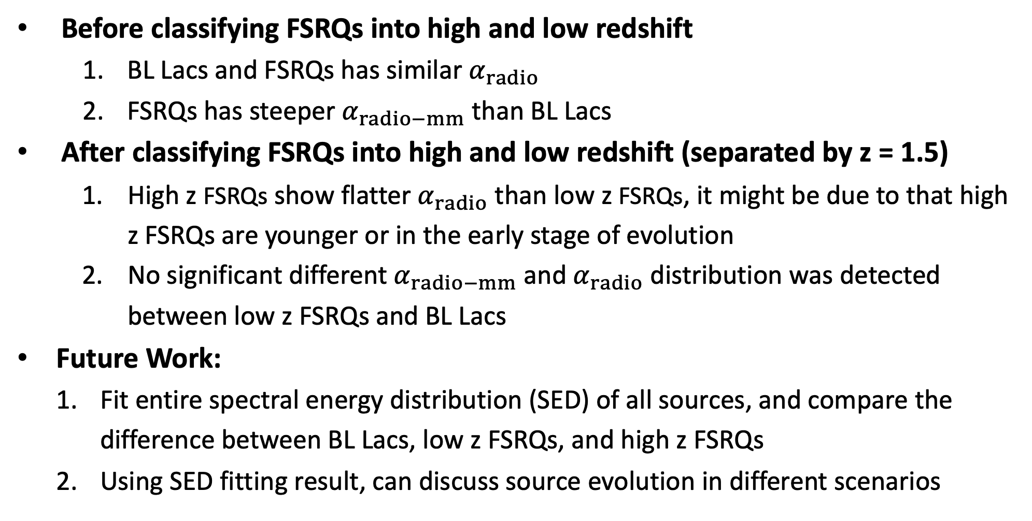
Conclusion
Before classifying FSRQs into high and low redshift
BL Lacs and FSRQs has similar $α_{radio}$
FSRQs has steeper $α_{radio−mm}$ than BL Lacs
After classifying FSRQs into high and low redshift (separated by z = 1.5)
High z FSRQs show flatter $α_{radio}$ than low z FSRQs, it might be due to that high z FSRQs are younger or in the early stage of evolution
No significant different $α_{radio−mm}$ and $α_{radio}$ distribution was detected between low z FSRQs and BL Lacs
Future Work:
Fit entire spectral energy distribution (SED) of all sources, and compare the difference between BL Lacs, low z FSRQs, and high z FSRQs
Using SED fitting result, can discuss source evolution in different scenarios

Slide 13
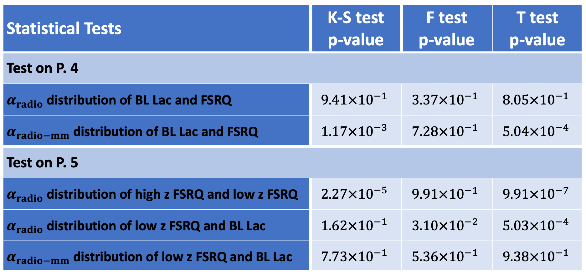
Statistical test
Statistical Tests | K-S test p-value | F test p-value | T test p-value
Test on P. 4
$α_{radio}$ distribution of BL Lac and FSRQ | $$9.41×{10}^{−1}$$ | $$3.37×{10}^{−1}$$ | $$8.05×{10}^{−1}$$
$α_{radio−mm}$ distribution of BL Lac and FSRQ | $$1.17×{10}^{−3}$$ | $$7.28×{10}^{−1}$$ | $$5.04×{10}^{−4}$$
Test on P. 5
$α_{radio}$ distribution of high z FSRQ and low z FSRQ | $$2.27×{10}^{−5}$$ | $$9.91×{10}^{−1}$$ | $$9.91×{10}^{−7}$$
$α_{radio}$ distribution of low z FSRQ and BL Lac | $$1.62×{10}^{−1}$$ | $$3.10×{10}^{−2}$$ | $$5.03×{10}^{−4}$$
$α_{radio−mm}$ distribution of low z FSRQ and BL Lac | $$7.73×{10}^{−1}$$ | $$5.36×{10}^{−1}$$ | $$9.38×{10}^{−1}$$

Slide 14
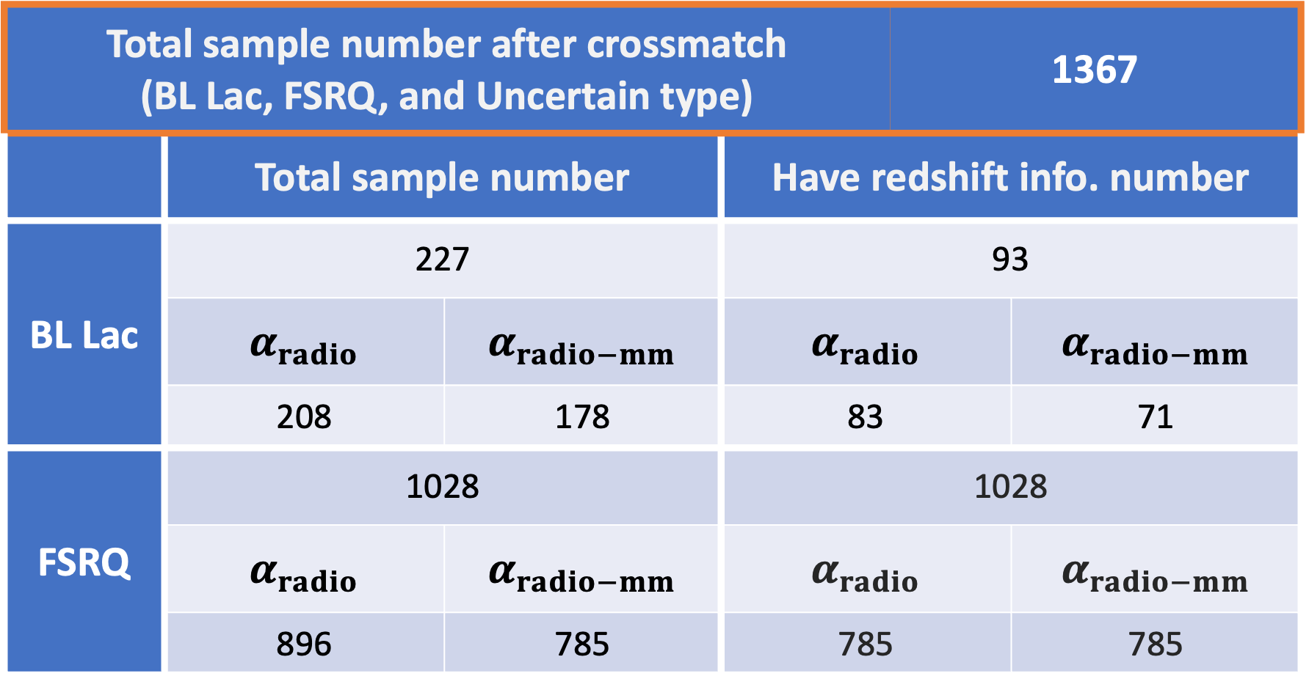
Sample Number Statistic
Total sample number after crossmatch (BL Lac, FSRQ, and Uncertain type) |  |  |  | 1367
 | Total sample number |  | Have redshift info. number
BL Lac | 227 |  | 93
 | $$α_{radio}$$ | $$α_{radio−mm}$$ | $$α_{radio}$$ |  | $$α_{radio−mm}$$
 | 208 | 178 | 83 |  | 71
FSRQ | 1028 |  | 1028
 | $$α_{radio}$$ | $$α_{radio−mm}$$ | $$α_{radio}$$ |  | $$α_{radio−mm}$$
 | 896 | 785 | 785 |  | 785
Notes:
may not have mm/sub-mm data
=> number decrease

Slide 15
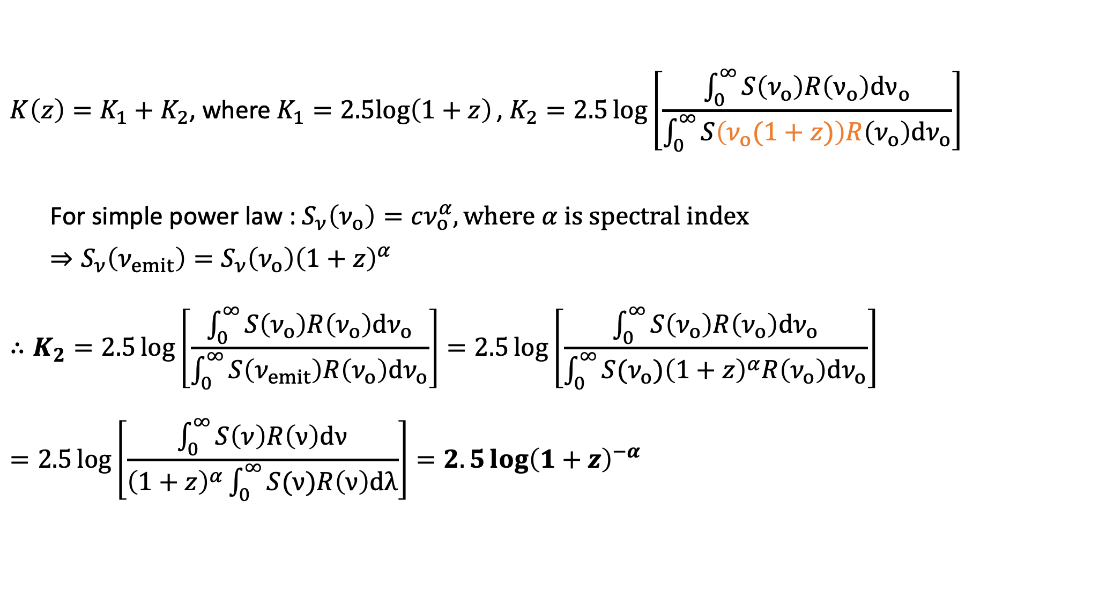

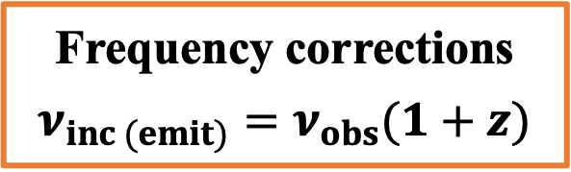
Appendix – K-correction
$$K\left(z\right)=K_{1}+K_{2}\text{, }\text{where} K_{1}=2.5log\left(1+z\right)\text{,} K_{2}=2.5\log\left[\frac{\int_{0}^{∞}{S\left(ν_{o}\right)R\left(ν_{o}\right)dν_{o}}}{\int_{0}^{∞}{S\left(ν_{ο}(1+z)\right)R\left(ν_{o}\right)dν_{o}}}\right]$$
For simple power law : $S_{ν}\left(ν_{o}\right)=cν_{o}^{α}, where α is spectral index$
$$⇒S_{ν}\left(ν_{emit}\right)=S_{ν}\left(ν_{ο}\right){\left(1+z\right)}^{α}$$
$$∴K_{2}=2.5\log\left[\frac{\int_{0}^{∞}{S\left(ν_{o}\right)R\left(ν_{o}\right)dν_{o}}}{\int_{0}^{∞}{S\left(ν_{emit}\right)R\left(ν_{o}\right)dν_{o}}}\right]=2.5\log\left[\frac{\int_{0}^{∞}{S\left(ν_{o}\right)R\left(ν_{o}\right)dν_{o}}}{\int_{0}^{∞}{S(ν_{ο}){\left(1+z\right)}^{α}R\left(ν_{o}\right)dν_{o}}}\right]$$
$$=2.5\log\left[\frac{\int_{0}^{∞}{S\left(ν\right)R\left(ν\right)dν}}{{\left(1+z\right)}^{α}\int_{0}^{∞}{S(ν)R\left(ν\right)dλ}}\right]=2.5\log{{\left(1+z\right)}^{−α}}$$
$$=F\left(ν_{emit}\right)$$
Frequency corrections
$$ν_{inc (emit)}=ν_{obs}(1+z)$$

Slide 16
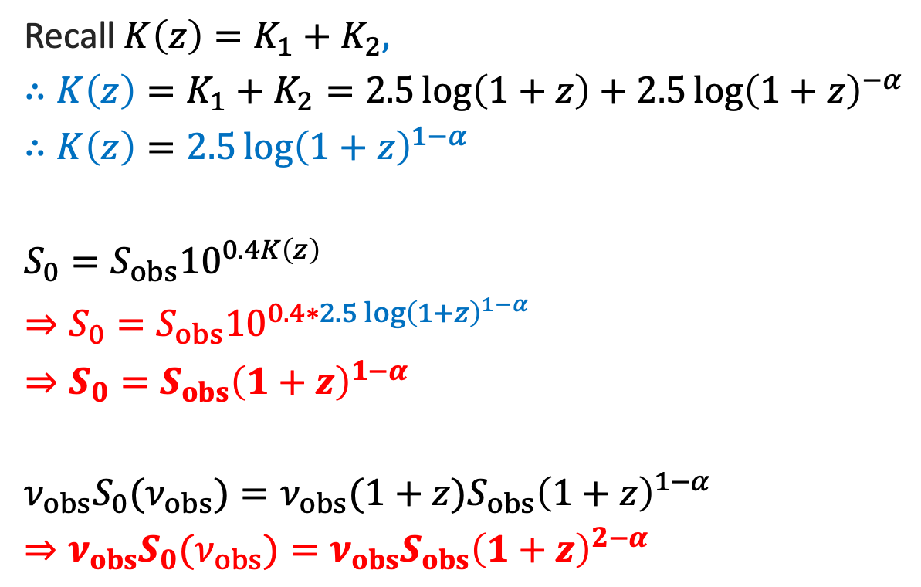
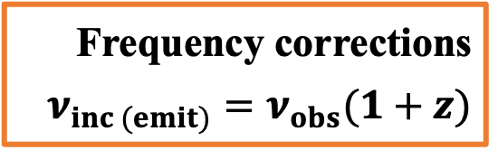
Appendix – K-correction
Recall $K\left(z\right)=K_{1}+K_{2}$,
$$∴K\left(z\right)=K_{1}+K_{2}=2.5\log\left(1+z\right)+2.5\log{{\left(1+z\right)}^{−α}}$$
$$∴K\left(z\right)=2.5{\log\left(1+z\right)}^{1−α}$$
$$S_{0}=S_{obs}{10}^{0.4K\left(z\right)}$$
$$⇒S_{0}=S_{obs}10^{0.4∗2.5{\log\left(1+z\right)}^{1−α}}$$
$$⇒S_{0}=S_{obs}{\left(1+z\right)}^{1−α}$$
$${ν_{obs}S}_{0}(ν_{obs})=ν_{obs}(1+z)S_{obs}{\left(1+z\right)}^{1−α}$$
$$⇒ν_{obs}S_{0}(ν_{obs})=ν_{obs}S_{obs}{\left(1+z\right)}^{2−α}$$
Frequency corrections
$$ν_{inc (emit)}=ν_{obs}(1+z)$$

Slide 17

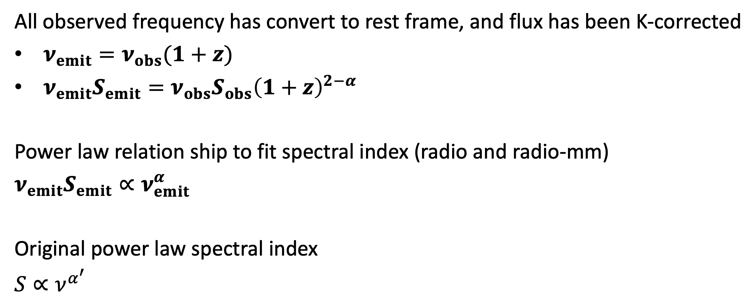
Appendix – spectral index
All observed frequency has convert to rest frame, and flux has been K-corrected
$ν_{emit}=ν_{obs}(1+z)$
$ν_{emit}S_{emit}=ν_{obs}S_{obs}{\left(1+z\right)}^{2−α}$
Power law relation ship to fit spectral index (radio and radio-mm)
$$ν_{emit}S_{emit}∝ν_{emit}^{α}$$
Original power law spectral index
$$S∝ν^{α^{′}}$$
spectral index minus 1
will be the spectral index usually used
$${α−1=α}^{′}$$

